Slide 1
Research in Cloud Security and Privacy --Security and Privacy Issues in Cloud Computing
Portions of this PPT draw from PPTs authored by
Bharat Bhargava, Anya Kim and YounSun Cho

Slide 2
Outline
Part I: Introduction
Part II. Security and Privacy Issues in Cloud Computing

Slide 3
Part I. Introduction
Why do you still hesitate to use cloud computing?
Causes of Problems Associated with Cloud Computing
Taxonomy of Fear
Threat Model

Slide 4
Cloud computing is great, why isn’t everyone doing it?
The cloud acts as a big black box, nothing inside the cloud is visible to the clients
Clients have no idea or control over what happens inside a cloud
Even if the cloud provider is honest, it can have malicious system admins who can tamper with the VMs and violate confidentiality and integrity
Clouds are still subject to traditional data confidentiality, integrity, availability, and privacy issues, plus some additional attacks

Slide 5
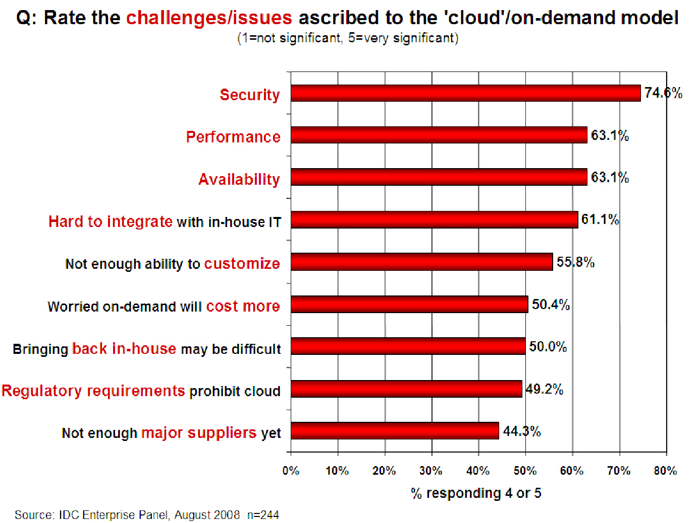
Companies are still afraid to use clouds
[Chow09ccsw]

Slide 6
Causes of Problems Associated with Cloud Computing
Most security problems stem from:
Loss of control
Lack of trust (mechanisms)
Multi-tenancy
These problems exist mainly in 3rd party management models
Self-managed clouds still have security issues, but not related to above
Notes:
6
Data mobility: the ability to share data between cloud services
Where does data reside?
- out-of-state, out-of-country issues
Security Concerns for government in particular
FISMA
How to certify and accredit cloud computing providers under FISMA
(e.g. ISO 27001)

Slide 7
Loss of Control in the Cloud
Consumer’s loss of control
Data, applications, resources are located with provider
User identity management is handled by the cloud
User access control rules, security policies and enforcement are managed by the cloud provider
Consumer relies on provider to ensure
Data security and privacy
Resource availability
Monitoring and repairing of services/resources

Slide 8
Lack of Trust in the Cloud
A brief deviation from the talk
(But still related)
Trusting a third party requires taking risks
Defining trust and risk
Opposite sides of the same coin (J. Camp)
People only trust when it pays (Economist’s view)
Need for trust arises only in risky situations
Defunct third party management schemes
Hard to balance trust and risk
e.g. Key Escrow (Clipper chip)
Is the cloud headed toward the same path?
Notes:
Chiles and McMakin (1996) define trust as increasing one’s vulnerability to the risk of opportunistic behavior of another whose behavior is not under one’s control in a situation in which the costs of violating the trust are greater than the benefits of upholding the trust.
Trust here means mostly lack of accountability and verifiability

Slide 9
Multi-tenancy Issues in the Cloud
Conflict between tenants’ opposing goals
Tenants share a pool of resources and have opposing goals
How does multi-tenancy deal with conflict of interest?
Can tenants get along together and ‘play nicely’ ?
If they can’t, can we isolate them?
How to provide separation between tenants?
Cloud Computing brings new threats
Multiple independent users share the same physical infrastructure
Thus an attacker can legitimately be in the same physical machine as the target
Notes:
Who are my neighbors? What is their objective? They present another facet of risk and trust requirements

Slide 10
Taxonomy of Fear
Confidentiality
Fear of loss of control over data
Will the sensitive data stored on a cloud remain confidential?
Will cloud compromises leak confidential client data
Will the cloud provider itself be honest and won’t peek into the data?
Integrity
How do I know that the cloud provider is doing the computations correctly?
How do I ensure that the cloud provider really stored my data without tampering with it?
From [5] www.cs.jhu.edu/~ragib/sp10/cs412

Slide 11
Taxonomy of Fear (cont.)
Availability
Will critical systems go down at the client, if the provider is attacked in a Denial of Service attack?
What happens if cloud provider goes out of business?
Would cloud scale well-enough?
Often-voiced concern
Although cloud providers argue their downtime compares well with cloud user’s own data centers
From [5] www.cs.jhu.edu/~ragib/sp10/cs412

Slide 12
Taxonomy of Fear (cont.)
Privacy issues raised via massive data mining
Cloud now stores data from a lot of clients, and can run data mining algorithms to get large amounts of information on clients
Increased attack surface
Entity outside the organization now stores and computes data, and so
Attackers can now target the communication link between cloud provider and client
Cloud provider employees can be phished
From [5] www.cs.jhu.edu/~ragib/sp10/cs412

Slide 13
Taxonomy of Fear (cont.)
Auditability and forensics (out of control of data)
Difficult to audit data held outside organization in a cloud
Forensics also made difficult since now clients don’t maintain data locally
Legal quagmire and transitive trust issues
Who is responsible for complying with regulations?
e.g., SOX, HIPAA, GLBA ?
If cloud provider subcontracts to third party clouds, will the data still be secure?
From [5] www.cs.jhu.edu/~ragib/sp10/cs412

Slide 14

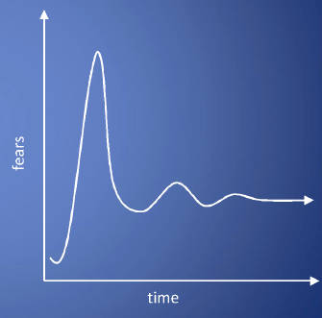
Taxonomy of Fear (cont.)
Cloud Computing is a security nightmare and it can't be handled in traditional ways.
John Chambers
CISCO CEO
Security is one of the most difficult task to implement in cloud computing.
Different forms of attacks in the application side and in the hardware components
Attacks with catastrophic effects only needs one security flaw
(http://www.exforsys.com/tutorials/cloud-computing/cloud-computing-security.html)

Slide 15
Threat Model
A threat model helps in analyzing a security problem, design mitigation strategies, and evaluate solutions
Steps:
Identify attackers, assets, threats and other components
Rank the threats
Choose mitigation strategies
Build solutions based on the strategies
From [5] www.cs.jhu.edu/~ragib/sp10/cs412

Slide 16
Threat Model
Basic components
Attacker modeling
Choose what attacker to consider
insider vs. outsider?
single vs. collaborator?
Attacker motivation and capabilities
Attacker goals
Vulnerabilities / threats
From [5] www.cs.jhu.edu/~ragib/sp10/cs412

Slide 17
What is the issue?
The core issue here is the levels of trust
Many cloud computing providers trust their customers
Each customer is physically commingling its data with data from anybody else using the cloud while logically and virtually you have your own space
The way that the cloud provider implements security is typically focused on the fact that those outside of their cloud are evil, and those inside are good.
But what if those inside are also evil?
From [5] www.cs.jhu.edu/~ragib/sp10/cs412

Slide 18
Attacker Capability: Malicious Insiders
At client
Learn passwords/authentication information
Gain control of the VMs
At cloud provider
Log client communication
Can read unencrypted data
Can possibly peek into VMs, or make copies of VMs
Can monitor network communication, application patterns
Why?
Gain information about client data
Gain information on client behavior
Sell the information or use itself
From [5] www.cs.jhu.edu/~ragib/sp10/cs412

Slide 19
Attacker Capability: Outside attacker
What?
Listen to network traffic (passive)
Insert malicious traffic (active)
Probe cloud structure (active)
Launch DoS
Goal?
Intrusion
Network analysis
Man in the middle
Cartography
From [5] www.cs.jhu.edu/~ragib/sp10/cs412

Slide 20
Challenges for the attacker
How to find out where the target is located?
How to be co-located with the target in the same (physical) machine?
How to gather information about the target?
From [5] www.cs.jhu.edu/~ragib/sp10/cs412

Slide 21
Part II: Security and Privacy Issues in Cloud Computing - Big Picture
Infrastructure Security
Data Security and Storage
Identity and Access Management (IAM)
Privacy
And more…
From [6] Cloud Security and Privacy by Mather and Kumaraswamy

Slide 22
Infrastructure Security
Network Level
Host Level
Application Level

Slide 23
The Network Level
Ensuring confidentiality and integrity of your organization’s data-in-transit to and from your public cloud provider
Ensuring proper access control (authentication, authorization, and auditing) to whatever resources you are using at your public cloud provider
Ensuring availability of the Internet-facing resources in a public cloud that are being used by your organization, or have been assigned to your organization by your public cloud providers
Replacing the established model of network zones and tiers with domains
From [6] Cloud Security and Privacy by Mather and Kumaraswamy

Slide 24
The Network Level - Mitigation
Note that network-level risks exist regardless of what aspects of “cloud computing” services are being used
The primary determination of risk level is therefore not which *aaS is being used,
But rather whether your organization intends to use or is using a public, private, or hybrid cloud.
From [6] Cloud Security and Privacy by Mather and Kumaraswamy

Slide 25
The Host Level
SaaS/PaaS
Both the PaaS and SaaS platforms abstract and hide the host OS from end users
Host security responsibilities are transferred to the CSP (Cloud Service Provider)
You do not have to worry about protecting hosts
However, as a customer, you still own the risk of managing information hosted in the cloud services.
From [6] Cloud Security and Privacy by Mather and Kumaraswamy

Slide 26
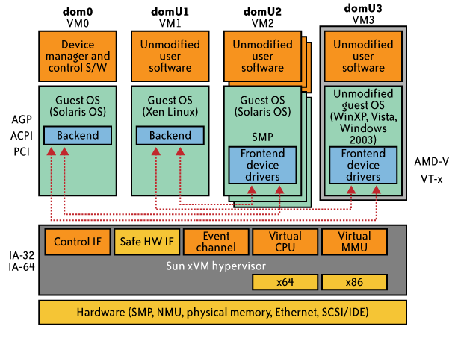
The Host Level (cont.)
IaaS Host Security
Virtualization Software Security
Hypervisor (also called Virtual Machine Manager (VMM)) security is a key
a small application that runs on top of the physical machine H/W layer
implements and manages the virtual CPU, virtual memory, event channels, and memory shared by the resident VMs
Also controls I/O and memory access to devices.
Bigger problem in multitenant architectures
Customer guest OS or Virtual Server Security
The virtual instance of an OS
Vulnerabilities have appeared in virtual instance of an OS
e.g., VMWare, Xen, and Microsoft’s Virtual PC and Virtual Server
Customers have full access to virtual servers.
From [6] Cloud Security and Privacy by Mather and Kumaraswamy

Slide 27
Case study: Amazon's EC2 infrastructure
“Hey, You, Get Off of My Cloud: Exploring Information Leakage in Third-Party Compute Clouds”
Multiple VMs of different organizations with virtual boundaries separating each VM can run within one physical server
"virtual machines" still have internet protocol, or IP, addresses, visible to anyone within the cloud.
VMs located on the same physical server tend to have IP addresses that are close to each other and are assigned at the same time
An attacker can set up lots of his own virtual machines, look at their IP addresses, and figure out which one shares the same physical resources as an intended target
Once the malicious virtual machine is placed on the same server as its target, it is possible to carefully monitor how access to resources fluctuates and thereby potentially glean sensitive information about the victim

Slide 28
Local Host Security
Are local host machines part of the cloud infrastructure?
Outside the security perimeter
While cloud consumers worry about the security on the cloud provider’s site, they may easily forget to harden their own machines
The lack of security of local devices can
Provide a way for malicious services on the cloud to attack local networks through these terminal devices
Compromise the cloud and its resources for other users
Notes:
The lack of security of local devices can disrupt the consumer and also provide a way for malicious services on the cloud to attack local networks through these terminal devices. In today’s ubiquitous computing environment, the local host machine may well be a desktop computer, a portable laptop or mobile device. While cloud consumers worry about the security on the cloud provider’s site, they may easily forget to harden their own machines. The lack of security of a local host can compromise the cloud and its resources for other users. With mobile devices, the threat may be even stronger, as users misplace or have the device stolen from them. The security mechanisms on handheld gadgets are often times insufficient compared to say, a desktop computer, providing a potential attacker an easy avenue into a cloud system. If a user relies mainly on a mobile device to access cloud data, the threat to availability is also increased as mobile devices malfunction or are lost.
Devices that access the cloud should have strong authentication mechanisms, should be tamper-resistant, and have cryptographic functionality when traffic confidentiality is required. Since this places a part of the security burden onto the consumer, the provider may need to stipulate in its policy or SLA. New approaches to mobile cloud computing in which applications lie in the cloud as opposed to on a smart phone, enable more sophisticated security mechanisms.
Users connect to the cloud from their local host machines.
In particular, many secure cloud data storing technologies require users to generate master keys (used to encrypt data or session keys) and store them on the local machine. If a malicious service in the cloud can tamper with the local machine and access these keys, confidentiality of data stored in the cloud is at risk.
For example, a user’s computer can be a zombie that can be used to attack the cloud. Or it can contain malicious code that damages provider-side resources, affecting not only the provider, but all its other consumers as well.
In today’s battle space, new technologies enable war fighters to use handheld devices to gather data for analysis at command centers. Therefore, the durability and robustness of these devices is a major concern not only for cloud computing but for general-purpose military use as well.
Memory curtaining techniques for sensitive areas of memories such as those places where keys are stored (i.e. provides isolation of sensitive memory areas). Remote attestation or TPM type requirements.

Slide 29
Local Host Security (Cont.)
With mobile devices, the threat may be even stronger
Users misplace or have the device stolen from them
Security mechanisms on handheld gadgets are often times insufficient compared to say, a desktop computer
Provides a potential attacker an easy avenue into a cloud system.
If a user relies mainly on a mobile device to access cloud data, the threat to availability is also increased as mobile devices malfunction or are lost
Devices that access the cloud should have
Strong authentication mechanisms
Tamper-resistant mechanisms
Strong isolation between applications
Methods to trust the OS
Cryptographic functionality when traffic confidentiality is required

Slide 30
The Application Level
DoS
EDoS(Economic Denial of Sustainability)
An attack against the billing model that underlies the cost of providing a service with the goal of bankrupting the service itself.
End user security
Who is responsible for Web application security in the cloud?
SaaS/PaaS/IaaS application security
Customer-deployed application security
From [6] Cloud Security and Privacy by Mather and Kumaraswamy

Slide 31
Data Security and Storage
Several aspects of data security, including:
Data-in-transit
Confidentiality + integrity using secured protocol
Confidentiality with non-secured protocol and encryption
Data-at-rest
Generally, not encrypted , since data is commingled with other users’ data
Encryption if it is not associated with applications?
But how about indexing and searching?
Then homomorphic encryption vs. predicate encryption?
Processing of data, including multitenancy
For any application to process data, not encrypted
From [6] Cloud Security and Privacy by Mather and Kumaraswamy

Slide 32
Data Security and Storage (cont.)
Data lineage
Knowing when and where the data was located w/i cloud is important for audit/compliance purposes
e.g., Amazon AWS
Store <d1, t1, ex1.s3.amazonaws.com>
Process <d2, t2, ec2.compute2.amazonaws.com>
Restore <d3, t3, ex2.s3.amazonaws.com>
Data provenance
Computational accuracy (as well as data integrity)
E.g., financial calculation: sum ((((2*3)*4)/6) -2) = $2.00 ?
Correct : assuming US dollar
How about dollars of different countries?
Correct exchange rate?
Where is (or was) that system located?
What was the state of that physical system?
How would a customer or auditor verify that info?
From [6] Cloud Security and Privacy by Mather and Kumaraswamy

Slide 33
Data Security and Storage
Data remanence
Inadvertent disclosure of sensitive information is possible
Data security mitigation?
Do not place any sensitive data in a public cloud
Encrypted data is placed into the cloud?
Provider data and its security: storage
To the extent that quantities of data from many companies are centralized, this collection can become an attractive target for criminals
Moreover, the physical security of the data center and the trustworthiness of system administrators take on new importance.
From [6] Cloud Security and Privacy by Mather and Kumaraswamy

Slide 34
Why IAM?
Organization’s trust boundary will become dynamic and will move beyond the control and will extend into the service provider domain.
Managing access for diverse user populations (employees, contractors, partners, etc.)
Increased demand for authentication
personal, financial, medical data will now be hosted in the cloud
S/W applications hosted in the cloud requires access control
Need for higher-assurance authentication
authentication in the cloud may mean authentication outside F/W
Limits of password authentication
Need for authentication from mobile devices
From [6] Cloud Security and Privacy by Mather and Kumaraswamy

Slide 35
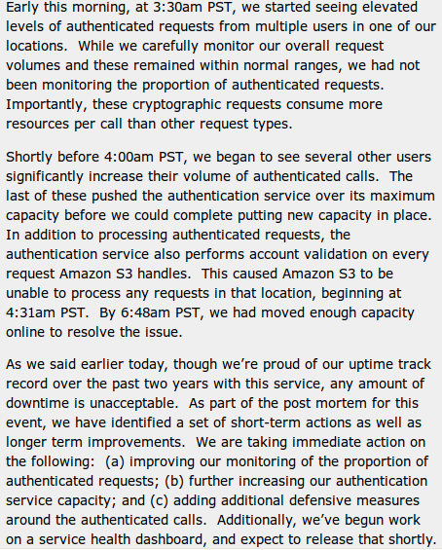
IAM considerations
The strength of authentication system should be reasonably balanced with the need to protect the privacy of the users of the system
The system should allow strong claims to be transmitted and verified w/o revealing more information than is necessary for any given transaction or connection within the service
Case Study: S3 outage
authentication service overload leading to unavailability
2 hours 2/15/08
http://www.centernetworks.com/amazon-s3-downtime-update

Slide 36
What is Privacy?
The concept of privacy varies widely among (and sometimes within) countries, cultures, and jurisdictions.
It is shaped by public expectations and legal interpretations; as such, a concise definition is elusive if not impossible.
Privacy rights or obligations are related to the collection, use, disclosure, storage, and destruction of personal data (or Personally Identifiable Information—PII).
At the end of the day, privacy is about the accountability of organizations to data subjects, as well as the transparency to an organization’s practice around personal information.
From [6] Cloud Security and Privacy by Mather and Kumaraswamy

Slide 37
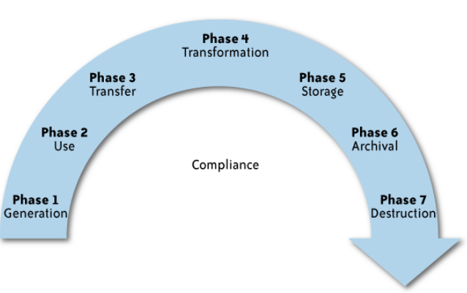
What is the data life cycle?
Personal information should be managed as part of the data used by the organization
Protection of personal information should consider the impact of the cloud on each phase
From [6] Cloud Security and Privacy by Mather and Kumaraswamy

Slide 38
What Are the Key Privacy Concerns?
Typically mix security and privacy
Some considerations to be aware of:
Storage
Retention
Destruction
Auditing, monitoring and risk management
Privacy breaches
Who is responsible for protecting privacy?
From [6] Cloud Security and Privacy by Mather and Kumaraswamy

Slide 39
Storage
Is it commingled with information from other organizations that use the same CSP?
The aggregation of data raises new privacy issues
Some governments may decide to search through data without necessarily notifying the data owner, depending on where the data resides
Whether the cloud provider itself has any right to see and access customer data?
Some services today track user behaviour for a range of purposes, from sending targeted advertising to improving services
From [6] Cloud Security and Privacy by Mather and Kumaraswamy

Slide 40
Retention
How long is personal information (that is transferred to the cloud) retained?
Which retention policy governs the data?
Does the organization own the data, or the CSP?
Who enforces the retention policy in the cloud, and how are exceptions to this policy (such as litigation holds) managed?
From [6] Cloud Security and Privacy by Mather and Kumaraswamy

Slide 41
Destruction
How does the cloud provider destroy PII at the end of the retention period?
How do organizations ensure that their PII is destroyed by the CSP at the right point and is not available to other cloud users?
Cloud storage providers usually replicate the data across multiple systems and sites—increased availability is one of the benefits they provide.
How do you know that the CSP didn’t retain additional copies?
Did the CSP really destroy the data, or just make it inaccessible to the organization?
Is the CSP keeping the information longer than necessary so that it can mine the data for its own use?
From [6] Cloud Security and Privacy by Mather and Kumaraswamy

Slide 42
Auditing, monitoring and risk management
How can organizations monitor their CSP and provide assurance to relevant stakeholders that privacy requirements are met when their PII is in the cloud?
Are they regularly audited?
What happens in the event of an incident?
If business-critical processes are migrated to a cloud computing model, internal security processes need to evolve to allow multiple cloud providers to participate in those processes, as needed.
These include processes such as security monitoring, auditing, forensics, incident response, and business continuity
From [6] Cloud Security and Privacy by Mather and Kumaraswamy

Slide 43
Privacy breaches
How do you know that a breach has occurred?
How do you ensure that the CSP notifies you when a breach occurs?
Who is responsible for managing the breach notification process (and costs associated with the process)?
If contracts include liability for breaches resulting from negligence of the CSP?
How is the contract enforced?
How is it determined who is at fault?
From [6] Cloud Security and Privacy by Mather and Kumaraswamy

Slide 44
Who is responsible for protecting privacy?
Data breaches have a cascading effect
Full reliance on a third party to protect personal data?
In-depth understanding of responsible data stewardship
Organizations can transfer liability, but not accountability
Risk assessment and mitigation throughout the data life cycle is critical.
Many new risks and unknowns
The overall complexity of privacy protection in the cloud represents a bigger challenge.
e.g., Suppose a hacker breaks into Cloud Provider A and steals data from Company X.
Assume that the compromised server also contained data from Companies Y and Z.
Who investigates this crime?
Is it the Cloud Provider, even though Company X may fear that
the provider will try to absolve itself from responsibility?
Is it Company X and, if so, does it have the right to see other data on that server,
including logs that may show access to the data of Companies Y and Z?
From [6] Cloud Security and Privacy by Mather and Kumaraswamy

Slide 45
Part III. Possible Solutions
Minimize Lack of Trust
Policy Language
Certification
Minimize Loss of Control
Monitoring
Utilizing different clouds
Access control management
Identity Management (IDM)
Minimize Multi-tenancy

Slide 46
References
NIST (Authors: P. Mell and T. Grance), "The NIST Definition of Cloud Computing (ver. 15)," National Institute of Standards and Technology, Information Technology Laboratory (October 7 2009).
J. McDermott, (2009) "Security Requirements for Virtualization in Cloud Computing," presented at the ACSAC Cloud Security Workshop, Honolulu, Hawaii, USA, 2009.
J. Camp. (2001), “Trust and Risk in Internet Commerce,” MIT Press
T. Ristenpart et al. (2009) “Hey You Get Off My Cloud,” Proceedings of the 16th ACM conference on Computer and communications security, Chicago, Illinois, USA
Security and Privacy in Cloud Computing, Dept. of CS at Johns Hopkins University. www.cs.jhu.edu/~ragib/sp10/cs412
Cloud Security and Privacy: An Enterprise Perspective on Risks and Compliance by Tim Mather and Subra Kumaraswamy
Afraid of outside cloud attacks? You're missing the real threat. http://www.infoworld.com/d/cloud-computing/afraid-outside-cloud-attacks-youre-missing-real-threat-894
Amazon downplays report highlighting vulnerabilities in its cloud service. http://www.computerworld.com/s/article/9140074/Amazon_downplays_report_highlighting_vulnerabilities_in_its_cloud_service
Targeted Attacks Possible in the Cloud, Researchers Warn. http://www.cio.com/article/506136/Targeted_Attacks_Possible_in_the_Cloud_Researchers_Warn
Vulnerability Seen in Amazon's Cloud-Computing by David Talbot. http://www.cs.sunysb.edu/~sion/research/sion2009mitTR.pdf
Cloud Computing Security Considerations by Roger Halbheer and Doug Cavit. January 2010. http://blogs.technet.com/b/rhalbheer/archive/2010/01/30/cloud-security-paper-looking-for-feedback.aspx
Security in Cloud Computing Overview.http://www.halbheer.info/security/2010/01/30/cloud-security-paper-looking-for-feedback
Hey, You, Get Off of My Cloud: Exploring Information Leakage in Third-Party Compute Clouds by T. Ristenpart, E. Tromer, H. Shacham and Stefan Savage. CCS’09
Cloud Computing Security. http://www.exforsys.com/tutorials/cloud-computing/cloud-computing-security.html
Update From Amazon Regarding Friday’s S3 Downtime by Allen Stern. Feb. 16, 2008. http://www.centernetworks.com/amazon-s3-downtime-update
R. Ranchal, B. Bhargava, L.B. Othmane, L. Lilien, A. Kim, M. Kang, “Protection of Identity Information in Cloud Computing without Trusted Third Party,“ Third International Workshop on Dependable Network Computing and Mobile Systems (DNCMS) in conjunction with 29th IEEE Symposium on Reliable Distributed System (SRDS) 2010
P. Angin, B. Bhargava, R. Ranchal, N. Singh, L. Lilien, L.B. Othmane, “A User-Centric Approach for Privacy and Identity Management in Cloud Computing,” 29th IEEE Symposium on Reliable Distributed System (SRDS) 2010
H. Khandelwal, et al., "Cloud Monitoring Framework,” Purdue University. Dec 2010.

Slide 47
Other References
M. Armbrust, et al., "Above the Clouds: A Berkeley View of Cloud Computing," UC Berkeley Reliable Adaptive Distributed Systems LaboratoryFebruary 10 2009.
Cloud Security Alliance, "Security Guidance for Critical Areas of Focus in Cloud Computing, ver. 2.1," 2009.
M. Jensen, et al., "On Technical Security Issues in Cloud Computing," presented at the 2009 IEEE International Conference on Cloud Computing, Bangalore, India 2009.
P. Mell and T. Grance, "Effectively and Securely Using the Cloud Computing Paradigm," ed: National Institute of Standards and Technology, Information Technology Laboratory, 2009.
N. Santos, et al., "Towards Trusted Cloud Computing," in Usenix 09 Hot Cloud Workshop, San Diego, CA, 2009.
R. G. Lennon, et al., "Best practices in cloud computing: designing for the cloud," presented at the Proceeding of the 24th ACM SIGPLAN conference companion on Object oriented programming systems languages and applications, Orlando, Florida, USA, 2009.
P. Mell and T. Grance, "The NIST Definition of Cloud Computing (ver. 15)," National Institute of Standards and Technology, Information Technology LaboratoryOctober 7 2009.
C. Cachin, et al., "Trusting the cloud," SIGACT News, vol. 40, pp. 81-86, 2009.
J. Heiser and M. Nicolett, "Assessing the Security Risks of Cloud Computing," Gartner 2008.
A. Joch. (2009, June 18) Cloud Computing: Is It Secure Enough? Federal Computer Week.
AWS Amazon EC2: http://aws.amazon.com/ec2/
Amazon CloudWatch: http://aws.amazon.com/cloudwatch/
Iperf: http://iperf.sourceforge.net/

